Slide 1
بسمه تعالی
موضوع: LINAC
ارائه دهنده: شعله قائدامینی

Slide 2
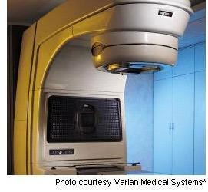
􀂃 What is this equipment used for?
􀂃 How does it work?
􀂃 Who operates this equipment?
􀂃 How is safety ensured?

Slide 3
What is this equipment used for?
A linear accelerator (LINAC) is the device most commonly
used for external beam radiation treatments for patients
with cancer. The linear
accelerator can also be used to treat areas outside of the
brain. It delivers a uniform dose of high-energy x-ray to
the region of the patient's tumor. These x-rays can
destroy the cancer cells while sparing the surrounding
normal tissue.

Slide 4
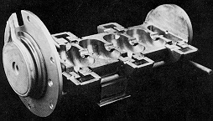
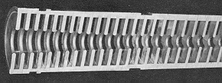
How does it work?
The linear accelerator uses microwave technology to accelerate electrons in a part of
the accelerator called the "wave guide", then allows these
electrons to collide with a heavy metal target. As a result
of the collisions, high-energy x-rays are scattered from
the target.

Slide 6
A portion of these x-rays is collected and then
shaped to form a beam that matches the patient's tumor.
The beam comes out of a part of the accelerator called a
gantry, which rotates around the patient. The patient lies
on a moveable treatment couch and lasers are used to
make sure the patient is in the proper position. Radiation
can be delivered to the tumor from any angle by rotating
the gantry and moving the treatment couch.

Slide 7
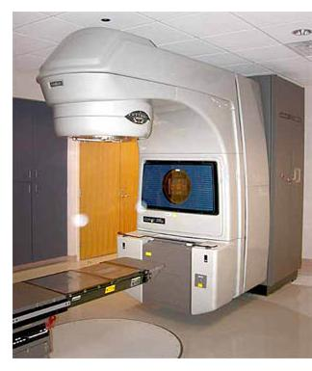

Slide 8
Who operates this equipment?
The patient's radiation oncologist prescribes
the appropriate treatment volume and dosage. The
medical radiation physicist and the dosimetrist determine
how to deliver the prescribed dose and calculate the
amount of time it will take the accelerator to deliver that
dose. Radiation therapists operate the linear accelerator
and give patients their daily radiation treatments.

Slide 9
How is safety ensured?
Patient safety is very important. During treatment the
radiation therapist continuously watches the patient
through a closed-circuit television monitor. There is also a
microphone in the treatment room so that the patient can
speak to the therapist if needed. Port films (x-rays taken
with the treatment beam) are checked regularly to make
sure that the beam position doesn't vary from the original
plan.

Slide 10
The linear accelerator sits in a room with lead and
concrete walls so that the high-energy x-rays do not
escape. The radiation therapist must turn on the
accelerator from outside the treatment room. Because the
accelerator only gives off radiation when it is actually
turned on, the risk of accidental exposure is extremely
low. Indeed, pregnant women are allowed to operate
linear accelerators.

Slide 11
Modern radiation machines have internal checking
systems to provide further safety so that the machine will
not turn on until all the treatment requirements
prescribed by your physician are perfect. When all the
checks match and are perfect, the machine will turn on to
give your treatment.

Slide 12
Quality control of the linear accelerator is also very
important. There are several systems built into the
accelerator so that it won't deliver a higher dose than the
radiation oncologist prescribed. the radiation physicist makes more detailed
weekly and monthly checks of the accelerator beam.

Slide 13
A linear particle accelerator consists of the following elements.
1- The particle ion source.
2- A high voltage source for the initial injection of particles.
3- A hollow pipe vacuum chamber.
4- cylindrical electrodes

Slide 14
5- One or more sources of radio frequency energy
6- An appropriate target
7- Additional magnetic or electrostatic lens

Slide 15
Schematic drawing of a linac

Slide 16
Treatment head

Slide 17
Advantages
Medical grade LINACs accelerate electrons using a complex bending
magnet arrangement and a 6-30 million electron-volt potential to treat
both benign and malignant disease. The reliability, flexibility and
accuracy of the radiation beam produced has largely supplanted cobalt
therapy as a treatment tool. In addition, the device can simply be powered
off when not in use; there is no source requiring heavy shielding.

Slide 18
مزایا:
1- مي توان در ابعاد و اندازه هاي مختلف ساخت.
2- هزينه ساخت و نگهداري آن كم بوده است.
3_ هيچ گونه زباله يا آلودگي محيطي توليد نمي كند. محصول نهايي آن آب خالص يا بخار آب است.
4 _ با استفاده از اين دستگاه عملاً عمر منابع انرژي نامحدود مي شود و منبع عظيمي از انرژي در دسترس خواهد بود.

Slide 19
Disadvantages
• The device length limits the locations where one may be placed.
• A great number of driver devices and their associated power
supplies are required, increasing the construction and maintenance
expense of this portion.

Slide 20
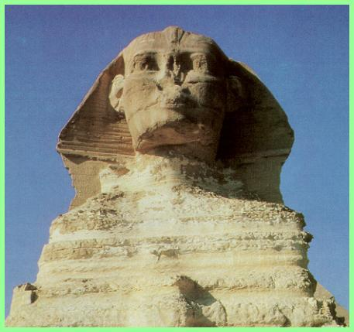
Any questions?

